Slide 1
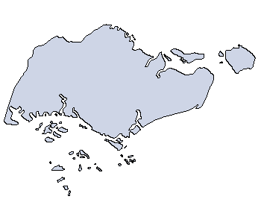




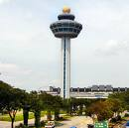






N
Woodlands
Pulau Ubin
Singapore Zoological Garden
MacRitchie Reservoir
Jurong
Botanic Garden
Serangoon
Changi Airport
Jurong Bird Park
Orchard
YZPS
Science centre
East Coast Park
City Hall
Esplanade
Sentosa

